Slide 1
ADJECTIVES: -ED or -ING
Frıghtened or frıghtnenıng

Slide 2
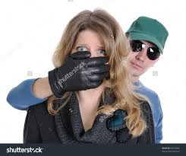
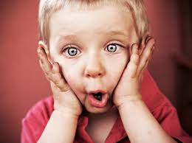
We can use adjectives that end with –ed to describe people’s feelings
Ann was very frightened. (The subject of the sentence (Ann) is the
person who has the feeling.
We are all surprised by the news.
(We feel surprised.)

Slide 3
I wasn’t nervous before the exam; I was relaxed.

Slide 4
Were you disappointed by the film?

Slide 5
The students are bored during the lesson.

Slide 6
I’m interested in your idea.

Slide 7
He was excited by the game ended.

Slide 8
I was very tired at the end of the journey.

Slide 9
We use an adjective thats ends with –ing to talk about a thing or a person that makes us have a feeling.
The ghost was very frightening.
The subject of the sentence(the ghost) causes the feeling.

Slide 10
The news is surprising.

Slide 11
The journey was tiring.

Slide 12
The end of the game was exciting.

Slide 13
Your idea is interesting.

Slide 14
The lesson was boring.

Slide 15
Was the film disappointing?

Slide 16
I went for a relaxing walk.

Slide 17
-ED -ING
Amused Amusing
Exhausted Exhausting
Embarrassed Embarrassing
Pleased Pleasing
Surprised Surprising
Thrilled Thrilling
Annoyed Annoying
Confused Confusing
Depressed Depressing
Disgusted Disgusting
Frightened Frightening
Horrified Horrifying
Shocked Shocking

Slide 18
Relaxed Relaxing
Fascinated Fascinating
Troubled Troubling
Puzzled Puzzling
Irritated Irritating
Devastated Devastating
Overwhelmed Overwhelming
Disappointed Disappointing

Slide 19
Intrigued Intriguing
Discouraged Discouraging
Moved Moving
Humiliated Humiliating
Satisfied Satisfying
Touched Touching
Scared Scaring

Slide 20
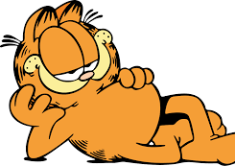
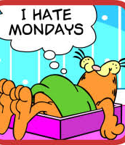

Slide 21
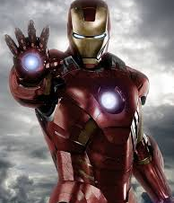

Slide 22
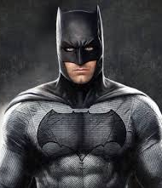

Slide 23
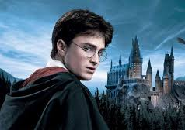

Slide 25
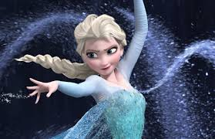

Slide 26
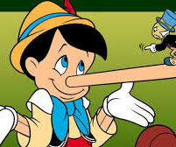

Slide 28
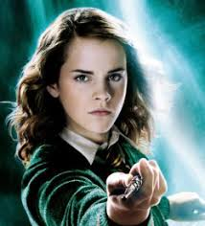
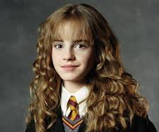
HERMIONE

Slide 29
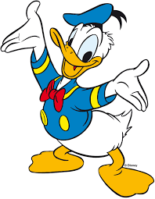
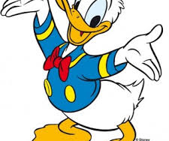

Slide 30
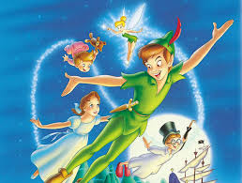

Slide 32
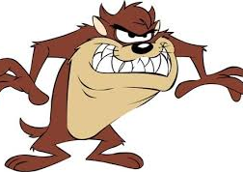
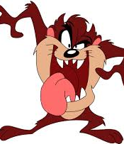

Slide 33
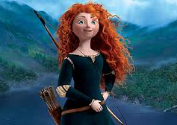

Slide 36
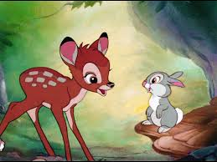
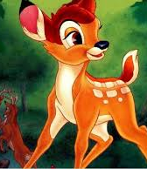

Slide 37
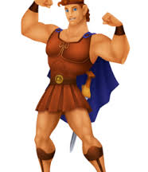

Slide 38
